Slide 1
Digital Design & Computer Arch. Lecture 22: More Caches
Prof. Onur Mutlu
ETH Zürich
Spring 2020
15 May 2020

Slide 2
Readings
Caches
Required
H&H Chapters 8.1-8.3
Refresh: P&P Chapter 3.5
Recommended
An early cache paper by Maurice Wilkes
Wilkes, “Slave Memories and Dynamic Storage Allocation,” IEEE Trans. On Electronic Computers, 1965.

Slide 3
Recall: Cache Structure
Address
Tag Store
(is the address
in the cache?
+ bookkeeping)
Data Store
(stores
memory
blocks)
Hit/miss?
Data

Slide 4
Recall: Set Associativity
Addresses 0 and 8 always conflict in direct mapped cache
Instead of having one column of 8, have 2 columns of 4 blocks
Tag store
Data store
SET
V
tag
V
tag
=?
=?
MUX
Logic
MUX
byte in block
Address
Hit?
tag
index
byte in block
Key idea: Associative memory within the set
+ Accommodates conflicts better (fewer conflict misses)
-- More complex, slower access, larger tag store
3b
2 bits
3 bits

Slide 5
What’s In A Tag Store Entry?
Valid bit
Tag
Replacement policy bits
Dirty bit?
Write back vs. write through caches

Slide 6
Handling Writes (I)
When do we write the modified data in a cache to the next level?
Write through: At the time the write happens
Write back: When the block is evicted
Write-back
+ Can combine multiple writes to the same block before eviction
Potentially saves bandwidth between cache levels + saves energy
-- Need a bit in the tag store indicating the block is “dirty/modified”
Write-through
+ Simpler
+ All levels are up to date. Consistency: Simpler cache coherence because no need to check close-to-processor caches’ tag stores for presence
-- More bandwidth intensive; no combining of writes

Slide 7
Handling Writes (II)
Do we allocate a cache block on a write miss?
Allocate on write miss: Yes
No-allocate on write miss: No
Allocate on write miss
+ Can combine writes instead of writing each of them individually to next level
+ Simpler because write misses can be treated the same way as read misses
-- Requires transfer of the whole cache block
No-allocate
+ Conserves cache space if locality of writes is low (potentially better cache hit rate)

Slide 8
Handling Writes (III)
What if the processor writes to an entire block over a small amount of time?
Is there any need to bring the block into the cache from memory in the first place?
Why do we not simply write to only a portion of the block, i.e., subblock
E.g., 4 bytes out of 64 bytes
Problem: Valid and dirty bits are associated with the entire 64 bytes, not with each individual 4 bytes

Slide 9
Subblocked (Sectored) Caches
Idea: Divide a block into subblocks (or sectors)
Have separate valid and dirty bits for each subblock (sector)
Allocate only a subblock (or a subset of subblocks) on a request
++ No need to transfer the entire cache block into the cache
(A write simply validates and updates a subblock)
++ More freedom in transferring subblocks into the cache (a cache block does not need to be in the cache fully)
(How many subblocks do you transfer on a read?)
-- More complex design
-- May not exploit spatial locality fully
subblock
v
d
subblock
v
d
subblock
v
d
tag

Slide 10
Instruction vs. Data Caches
Separate or Unified?
Pros and Cons of Unified:
+ Dynamic sharing of cache space: no overprovisioning that might happen with static partitioning (i.e., separate I and D caches)
-- Instructions and data can thrash each other (i.e., no guaranteed space for either)
-- I and D are accessed in different places in the pipeline. Where do we place the unified cache for fast access?
First level caches are almost always split
Mainly for the last reason above
Higher level caches are almost always unified

Slide 11
Multi-level Caching in a Pipelined Design
First-level caches (instruction and data)
Decisions very much affected by cycle time
Small, lower associativity; latency is critical
Tag store and data store accessed in parallel
Second-level caches
Decisions need to balance hit rate and access latency
Usually large and highly associative; latency not as important
Tag store and data store accessed serially
Serial vs. Parallel access of levels
Serial: Second level cache accessed only if first-level misses
Second level does not see the same accesses as the first
First level acts as a filter (filters some temporal and spatial locality)
Management policies are therefore different

Slide 12
Cache Performance

Slide 13
Cache Parameters vs. Miss/Hit Rate
Cache size
Block size
Associativity
Replacement policy
Insertion/Placement policy

Slide 14
Cache Size
Cache size: total data (not including tag) capacity
bigger can exploit temporal locality better
not ALWAYS better
Too large a cache adversely affects hit and miss latency
smaller is faster => bigger is slower
access time may degrade critical path
Too small a cache
doesn’t exploit temporal locality well
useful data replaced often
Working set: the whole set of data the executing application references
Within a time interval
hit rate
“working set”
size
cache size

Slide 15
Block Size
Block size is the data that is associated with an address tag
not necessarily the unit of transfer between hierarchies
Sub-blocking: A block divided into multiple pieces (each w/ V/D bits)
Too small blocks
don’t exploit spatial locality well
have larger tag overhead
Too large blocks
too few total # of blocks → less
temporal locality exploitation
waste of cache space and bandwidth/energy
if spatial locality is not high
hit rate
block
size

Slide 16
Large Blocks: Critical-Word and Subblocking
Large cache blocks can take a long time to fill into the cache
fill cache line critical word first
restart cache access before complete fill
Large cache blocks can waste bus bandwidth
divide a block into subblocks
associate separate valid and dirty bits for each subblock
Recall: When is this useful?
subblock
v
d
subblock
v
d
subblock
v
d
tag

Slide 17
Associativity
How many blocks can be present in the same index (i.e., set)?
Larger associativity
lower miss rate (reduced conflicts)
higher hit latency and area cost (plus diminishing returns)
Smaller associativity
lower cost
lower hit latency
Especially important for L1 caches
Is power of 2 associativity required?
hit rate
associativity

Slide 18
Classification of Cache Misses
Compulsory miss
first reference to an address (block) always results in a miss
subsequent references should hit unless the cache block is displaced for the reasons below
Capacity miss
cache is too small to hold everything needed
defined as the misses that would occur even in a fully-associative cache (with optimal replacement) of the same capacity
Conflict miss
defined as any miss that is neither a compulsory nor a capacity miss

Slide 19
How to Reduce Each Miss Type
Compulsory
Caching cannot help
Prefetching can: Anticipate which blocks will be needed soon
Conflict
More associativity
Other ways to get more associativity without making the cache associative
Victim cache
Better, randomized indexing
Software hints?
Capacity
Utilize cache space better: keep blocks that will be referenced
Software management: divide working set and computation such that each “computation phase” fits in cache

Slide 20
How to Improve Cache Performance
Three fundamental goals
Reducing miss rate
Caveat: reducing miss rate can reduce performance if more costly-to-refetch blocks are evicted
Reducing miss latency or miss cost
Reducing hit latency or hit cost
The above three together affect performance

Slide 21
Improving Basic Cache Performance
Reducing miss rate
More associativity
Alternatives/enhancements to associativity
Victim caches, hashing, pseudo-associativity, skewed associativity
Better replacement/insertion policies
Software approaches
Reducing miss latency/cost
Multi-level caches
Critical word first
Subblocking/sectoring
Better replacement/insertion policies
Non-blocking caches (multiple cache misses in parallel)
Multiple accesses per cycle
Software approaches

Slide 22
Software Approaches for Higher Hit Rate
Restructuring data access patterns
Restructuring data layout
Loop interchange
Data structure separation/merging
Blocking
…

Slide 23
Restructuring Data Access Patterns (I)
Idea: Restructure data layout or data access patterns
Example: If column-major
x[i+1,j] follows x[i,j] in memory
x[i,j+1] is far away from x[i,j]
This is called loop interchange
Other optimizations can also increase hit rate
Loop fusion, array merging, …
Poor code
for i = 1, rows
for j = 1, columns
sum = sum + x[i,j]
Better code
for j = 1, columns
for i = 1, rows
sum = sum + x[i,j]

Slide 24
Restructuring Data Access Patterns (II)
Blocking
Divide loops operating on arrays into computation chunks so that each chunk can hold its data in the cache
Avoids cache conflicts between different chunks of computation
Essentially: Divide the working set so that each piece fits in the cache
Also called Tiling

Slide 25
Restructuring Data Layout (I)
Pointer based traversal (e.g., of a linked list)
Assume a huge linked list (1B nodes) and unique keys
Why does the code on the left have poor cache hit rate?
“Other fields” occupy most of the cache line even though rarely accessed!
struct Node {
struct Node* next;
int key;
char [256] name;
char [256] school;
}
while (node) {
if (node→key == input-key) {
// access other fields of node
}
node = node→next;
}

Slide 26
Restructuring Data Layout (II)
struct Node {
struct Node* next;
int key;
struct Node-data* node-data;
}
struct Node-data {
char [256] name;
char [256] school;
}
while (node) {
if (node→key == input-key) {
// access node→node-data
}
node = node→next;
}
Idea: separate frequently-used fields of a data structure and pack them into a separate data structure
Who should do this?
Programmer
Compiler
Profiling vs. dynamic
Hardware?
Who can determine what is frequently used?

Slide 27
Multi-Core Issues in Caching

Slide 28
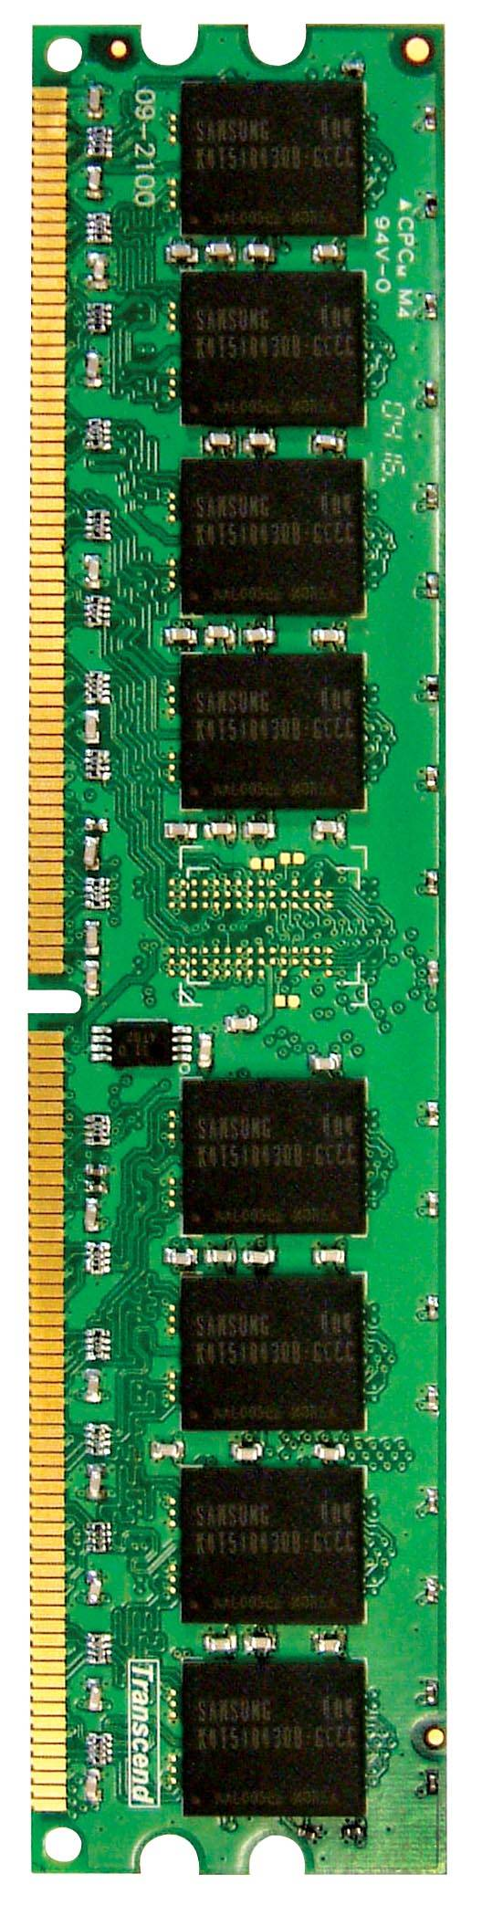
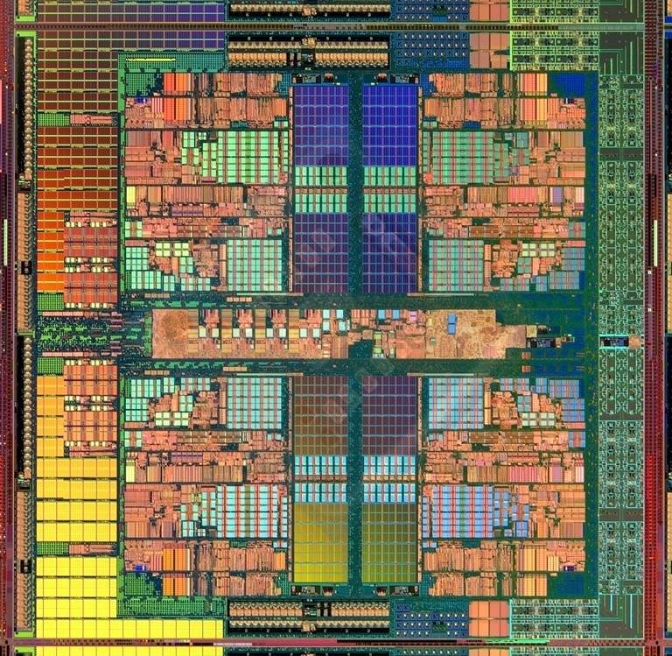
Caches in a Multi-Core System
CORE 0
L2 CACHE 1
CORE 1
L2 CACHE 0
SHARED L3 CACHE
DRAM INTERFACE
DRAM MEMORY CONTROLLER
DRAM BANKS
L2 CACHE 2
CORE 3
CORE 2
L2 CACHE 3

Slide 29
Caches in Multi-Core Systems
Cache efficiency becomes even more important in a multi-core/multi-threaded system
Memory bandwidth is at premium
Cache space is a limited resource across cores/threads
How do we design the caches in a multi-core system?
Many decisions
Shared vs. private caches
How to maximize performance of the entire system?
How to provide QoS to different threads in a shared cache?
Should cache management algorithms be aware of threads?
How should space be allocated to threads in a shared cache?

Slide 30
Private vs. Shared Caches
Private cache: Cache belongs to one core (a shared block can be in multiple caches)
Shared cache: Cache is shared by multiple cores
CORE 0
CORE 1
CORE 2
CORE 3
CORE 0
CORE 1
CORE 2
CORE 3
L2
CACHE
L2
CACHE
L2
CACHE
L2
CACHE
L2
CACHE
DRAM MEMORY CONTROLLER
DRAM MEMORY CONTROLLER

Slide 31
Resource Sharing Concept and Advantages
Idea: Instead of dedicating a hardware resource to a hardware context, allow multiple contexts to use it
Example resources: functional units, pipeline, caches, buses, memory
Why?
+ Resource sharing improves utilization/efficiency → throughput
When a resource is left idle by one thread, another thread can use it; no need to replicate shared data
+ Reduces communication latency
For example, data shared between multiple threads can be kept in the same cache in multithreaded processors
+ Compatible with the shared memory programming model

Slide 32
Resource Sharing Disadvantages
Resource sharing results in contention for resources
When the resource is not idle, another thread cannot use it
If space is occupied by one thread, another thread needs to re-occupy it
- Sometimes reduces each or some thread’s performance
- Thread performance can be worse than when it is run alone
- Eliminates performance isolation → inconsistent performance across runs
- Thread performance depends on co-executing threads
- Uncontrolled (free-for-all) sharing degrades QoS
- Causes unfairness, starvation
Need to efficiently and fairly utilize shared resources

Slide 33
Private vs. Shared Caches
Private cache: Cache belongs to one core (a shared block can be in multiple caches)
Shared cache: Cache is shared by multiple cores
CORE 0
CORE 1
CORE 2
CORE 3
CORE 0
CORE 1
CORE 2
CORE 3
L2
CACHE
L2
CACHE
L2
CACHE
L2
CACHE
L2
CACHE
DRAM MEMORY CONTROLLER
DRAM MEMORY CONTROLLER

Slide 34
Shared Caches Between Cores
Advantages:
High effective capacity
Dynamic partitioning of available cache space
No fragmentation due to static partitioning
If one core does not utilize some space, another core can
Easier to maintain coherence (a cache block is in a single location)
Disadvantages
Slower access (cache not tightly coupled with the core)
Cores incur conflict misses due to other cores’ accesses
Misses due to inter-core interference
Some cores can destroy the hit rate of other cores
Guaranteeing a minimum level of service (or fairness) to each core is harder (how much space, how much bandwidth?)

Slide 35
Cache Coherence

Slide 36
Cache Coherence
Basic question: If multiple processors cache the same block, how do they ensure they all see a consistent state?
P1
P2
Interconnection Network
1000
x
Main Memory

Slide 37
The Cache Coherence Problem
P1
P2
ld r2, x
1000
Interconnection Network
1000
x
Main Memory

Slide 38
The Cache Coherence Problem
P1
P2
ld r2, x
ld r2, x
1000
1000
Interconnection Network
x
1000
Main Memory

Slide 39
The Cache Coherence Problem
P1
P2
ld r2, x
ld r2, x
add r1, r2, r4
st x, r1
2000
1000
Interconnection Network
1000
x
Main Memory

Slide 40
The Cache Coherence Problem
P1
P2
ld r2, x
ld r2, x
add r1, r2, r4
st x, r1
2000
1000
Should NOT load 1000
ld r5, x
Interconnection Network
1000
x
Main Memory

Slide 41
Digital Design & Computer Arch. Lecture 22: More Caches
Prof. Onur Mutlu
ETH Zürich
Spring 2020
15 May 2020

Slide 42
Cache Examples: For You to Study

Slide 43
Cache Terminology
Capacity (C):
the number of data bytes a cache stores
Block size (b):
bytes of data brought into cache at once
Number of blocks (B = C/b):
number of blocks in cache: B = C/b
Degree of associativity (N):
number of blocks in a set
Number of sets (S = B/N):
each memory address maps to exactly one cache set

Slide 44
How is data found?
Cache organized into S sets
Each memory address maps to exactly one set
Caches categorized by number of blocks in a set:
Direct mapped: 1 block per set
N-way set associative: N blocks per set
Fully associative: all cache blocks are in a single set
Examine each organization for a cache with:
Capacity (C = 8 words)
Block size (b = 1 word)
So, number of blocks (B = 8)

Slide 45
Direct Mapped Cache

Slide 46
Direct Mapped Cache Hardware

Slide 47
Direct Mapped Cache Performance
# MIPS assembly code
addi $t0, $0, 5
loop: beq $t0, $0, done
lw $t1, 0x4($0)
lw $t2, 0xC($0)
lw $t3, 0x8($0)
addi $t0, $t0, -1
j loop
done:
Miss Rate =
47

Slide 48
Direct Mapped Cache Performance
# MIPS assembly code
addi $t0, $0, 5
loop: beq $t0, $0, done
lw $t1, 0x4($0)
lw $t2, 0xC($0)
lw $t3, 0x8($0)
addi $t0, $t0, -1
j loop
done:
Miss Rate = 3/15 = 20%
Temporal Locality Compulsory Misses
48

Slide 49
Direct Mapped Cache: Conflict
# MIPS assembly code
addi $t0, $0, 5
loop: beq $t0, $0, done
lw $t1, 0x4($0)
lw $t2, 0x24($0)
addi $t0, $t0, -1
j loop
done:
Miss Rate =
49

Slide 50
Direct Mapped Cache: Conflict
# MIPS assembly code
addi $t0, $0, 5
loop: beq $t0, $0, done
lw $t1, 0x4($0)
lw $t2, 0x24($0)
addi $t0, $t0, -1
j loop
done:
Miss Rate = 10/10 = 100%
Conflict Misses
50

Slide 51
N-Way Set Associative Cache

Slide 52
N-way Set Associative Performance
# MIPS assembly code
addi $t0, $0, 5
loop: beq $t0, $0, done
lw $t1, 0x4($0)
lw $t2, 0x24($0)
addi $t0, $t0, -1
j loop
done:
Miss Rate =
52

Slide 53
N-way Set Associative Performance
# MIPS assembly code
addi $t0, $0, 5
loop: beq $t0, $0, done
lw $t1, 0x4($0)
lw $t2, 0x24($0)
addi $t0, $t0, -1
j loop
done:
Miss Rate = 2/10
= 20%
Associativity reduces conflict misses
53

Slide 54
Fully Associative Cache
No conflict misses
Expensive to build
54

Slide 55
Spatial Locality?
Increase block size:
Block size, b = 4 words
C = 8 words
Direct mapped (1 block per set)
Number of blocks, B = C/b = 8/4 = 2
55

Slide 56
Direct Mapped Cache Performance
addi $t0, $0, 5
loop: beq $t0, $0, done
lw $t1, 0x4($0)
lw $t2, 0xC($0)
lw $t3, 0x8($0)
addi $t0, $t0, -1
j loop
done:
Miss Rate =
56

Slide 57
Direct Mapped Cache Performance
addi $t0, $0, 5
loop: beq $t0, $0, done
lw $t1, 0x4($0)
lw $t2, 0xC($0)
lw $t3, 0x8($0)
addi $t0, $t0, -1
j loop
done:
Miss Rate = 1/15
= 6.67%
Larger blocks reduce compulsory misses through spatial locality
57

Slide 58
Cache Organization Recap
Main Parameters
Capacity: C
Block size: b
Number of blocks in cache: B = C/b
Number of blocks in a set: N
Number of Sets: S = B/N
Organization | Number of Ways (N) | Number of Sets (S = B/N)
Direct Mapped | 1 | B
N-Way Set Associative | 1 < N < B | B / N
Fully Associative | B | 1
58

Slide 59
Capacity Misses
Cache is too small to hold all data of interest at one time
If the cache is full and program tries to access data X that is not in cache, cache must evict data Y to make room for X
Capacity miss occurs if program then tries to access Y again
X will be placed in a particular set based on its address
In a direct mapped cache, there is only one place to put X
In an associative cache, there are multiple ways where X could go in the set.
How to choose Y to minimize chance of needing it again?
Least recently used (LRU) replacement: the least recently used block in a set is evicted when the cache is full.

Slide 60
Types of Misses
Compulsory: first time data is accessed
Capacity: cache too small to hold all data of interest
Conflict: data of interest maps to same location in cache
Miss penalty: time it takes to retrieve a block from lower level of hierarchy

Slide 61
LRU Replacement
# MIPS assembly
lw $t0, 0x04($0)
lw $t1, 0x24($0)
lw $t2, 0x54($0)
61

Slide 62
LRU Replacement
# MIPS assembly
lw $t0, 0x04($0)
lw $t1, 0x24($0)
lw $t2, 0x54($0)
62

